Slide 1
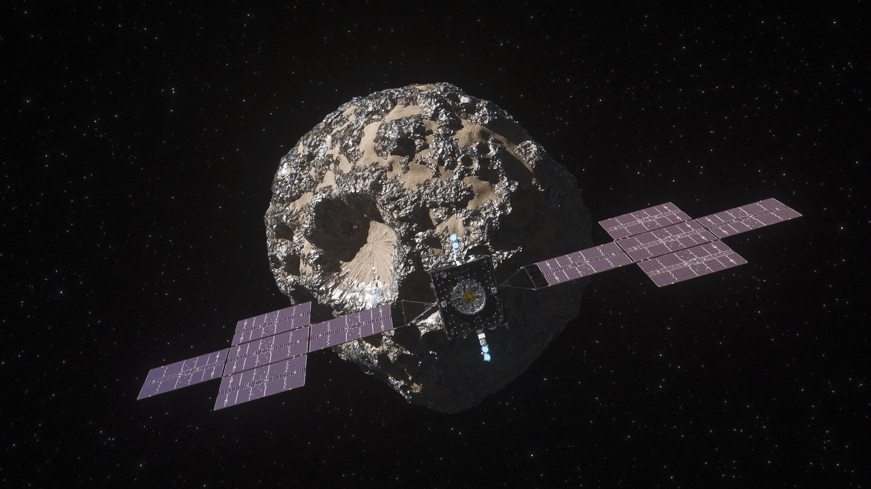
Meteorite Imaging and Database
By: Samantha Beauchaine

Slide 2
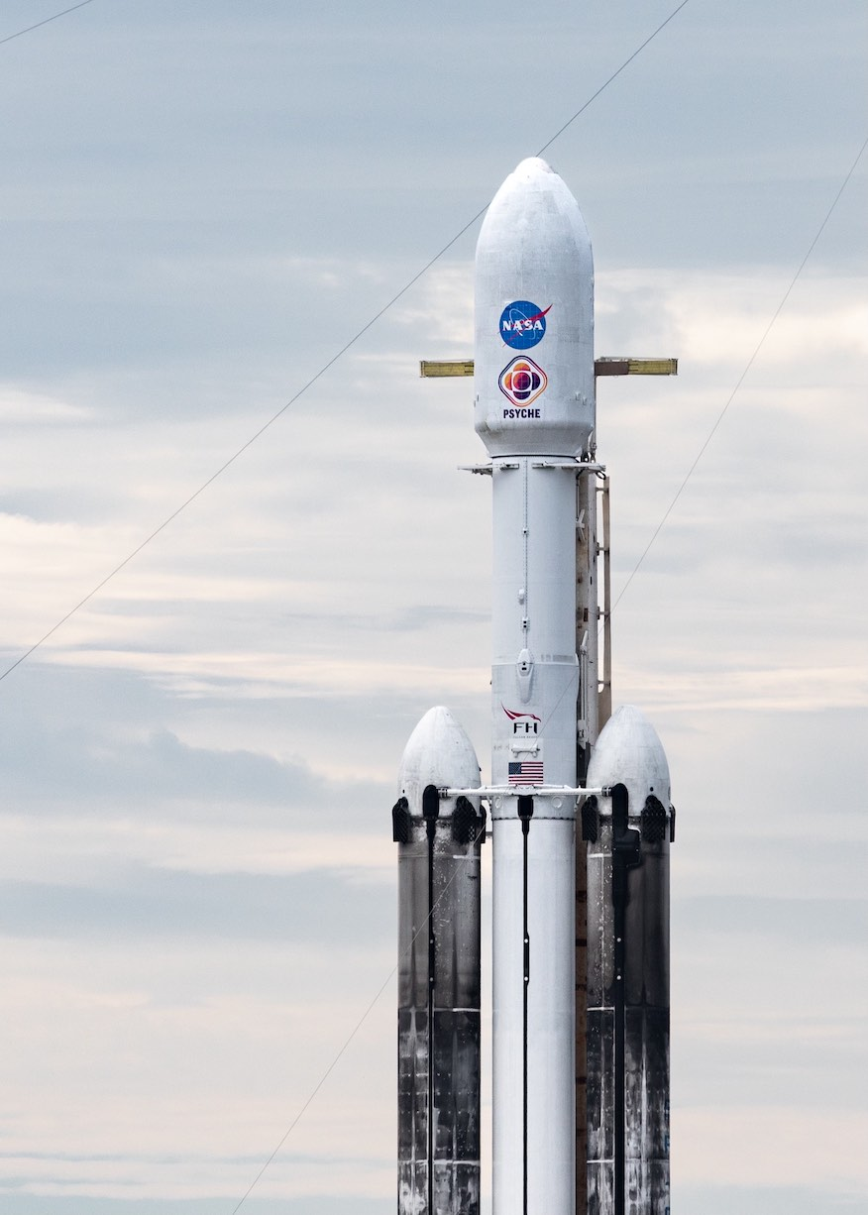
New data on density, radar properties, and spectral signatures indicate that the Psyche asteroid is possibly a mixed metal and silicate world.
Analysis indicates that Psyche is likely made of a mixture of rock and metal, with metal comprising between 30-60% of its volume.

Slide 3
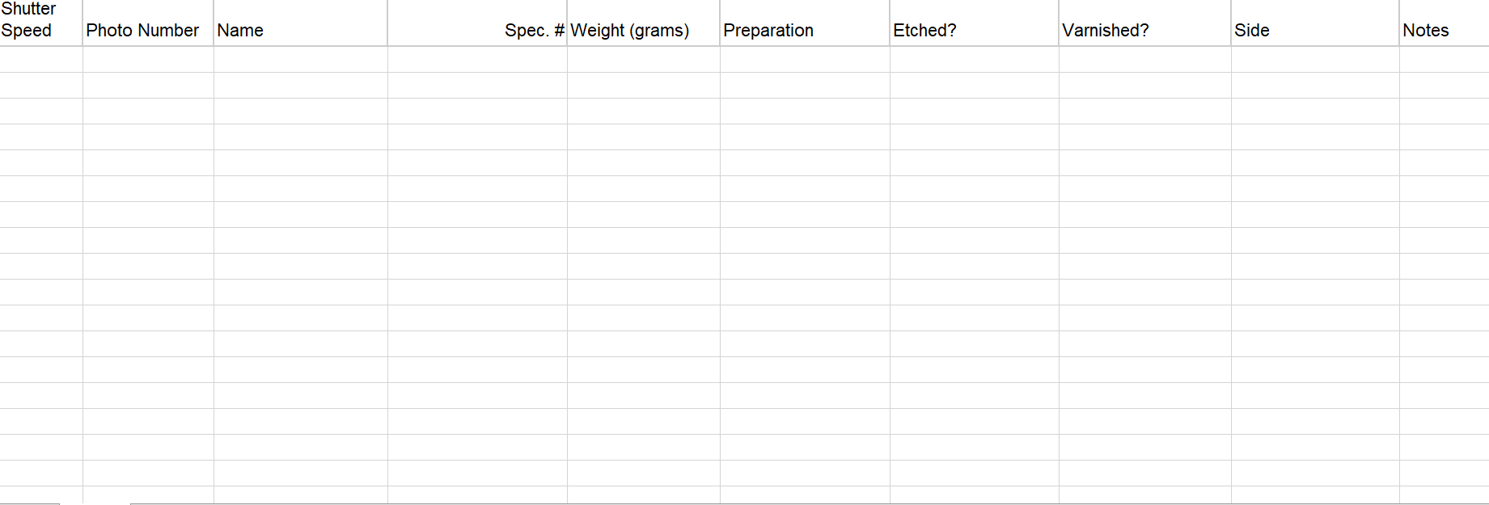
The images obtained using the system will be added to a database that can be analyzed in the future to determine sample compositions for reference in determining Psyche asteroids composition.

Slide 4
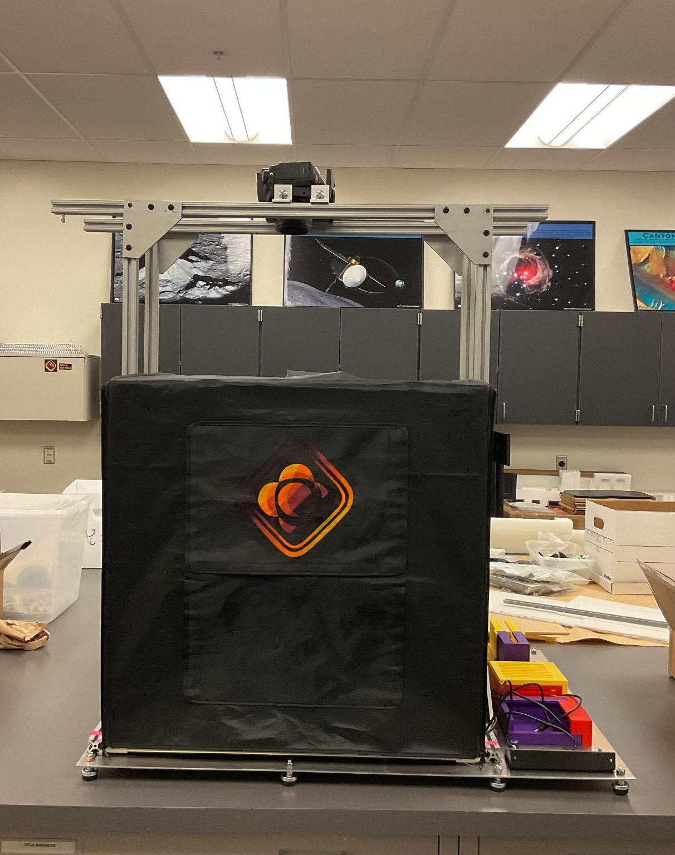
SAMI
System for Analyzing Meteorite Inclusions
Images obtained using SAMI will serve as references in later comparisons of images collected from the Psyche mission.

Slide 5
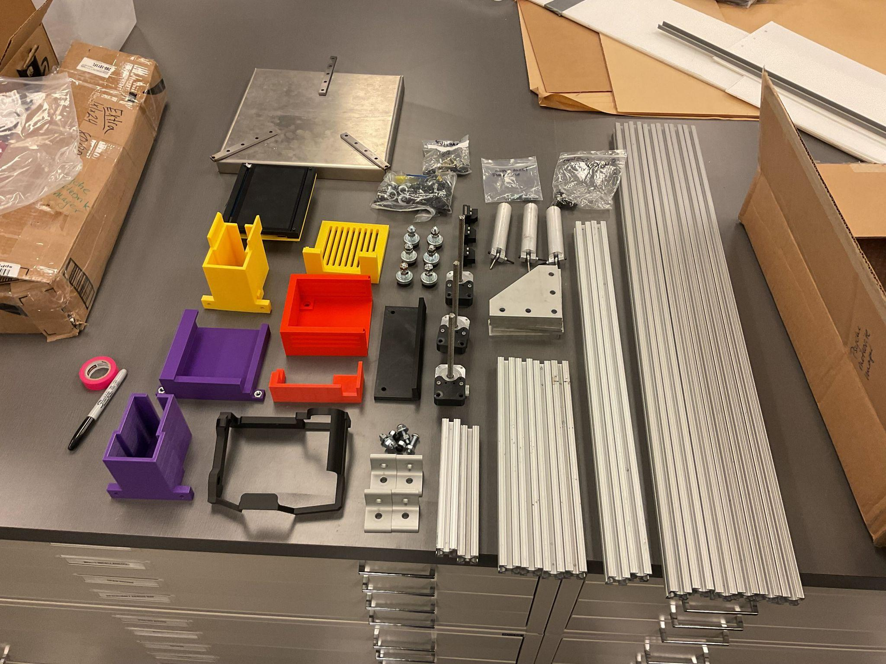
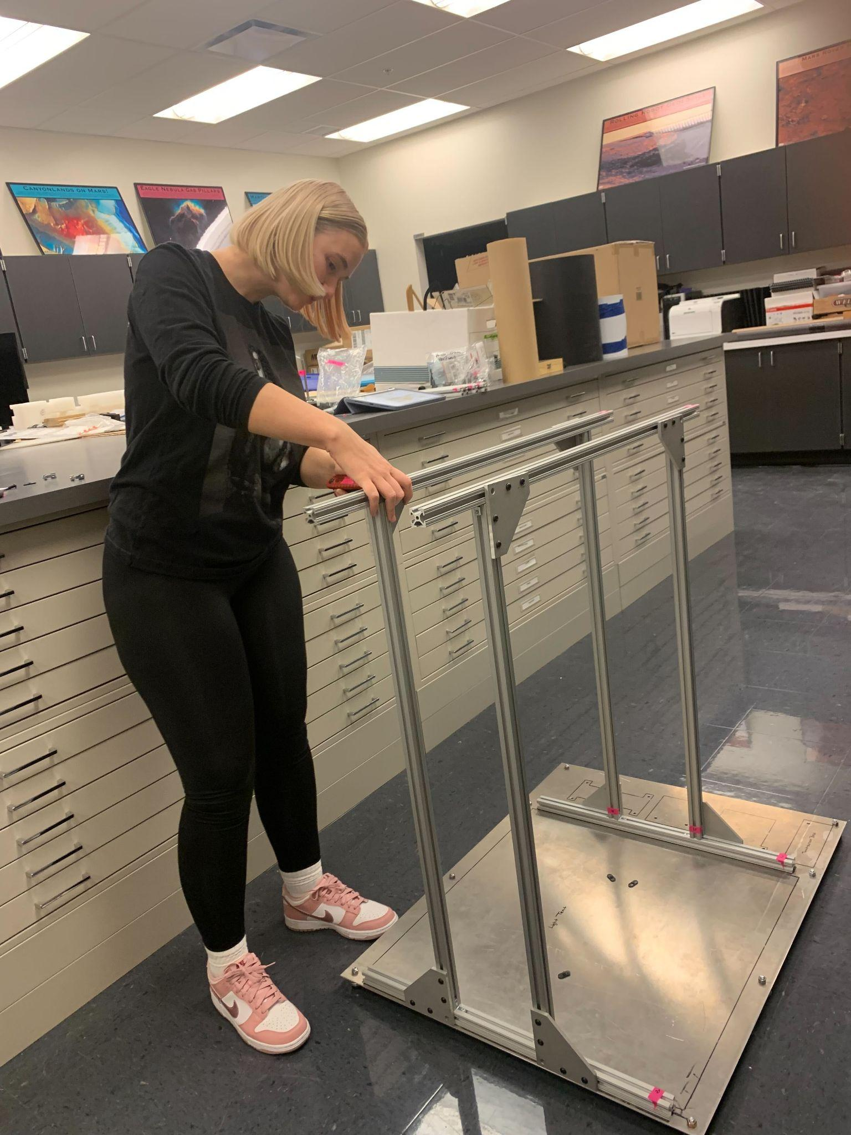
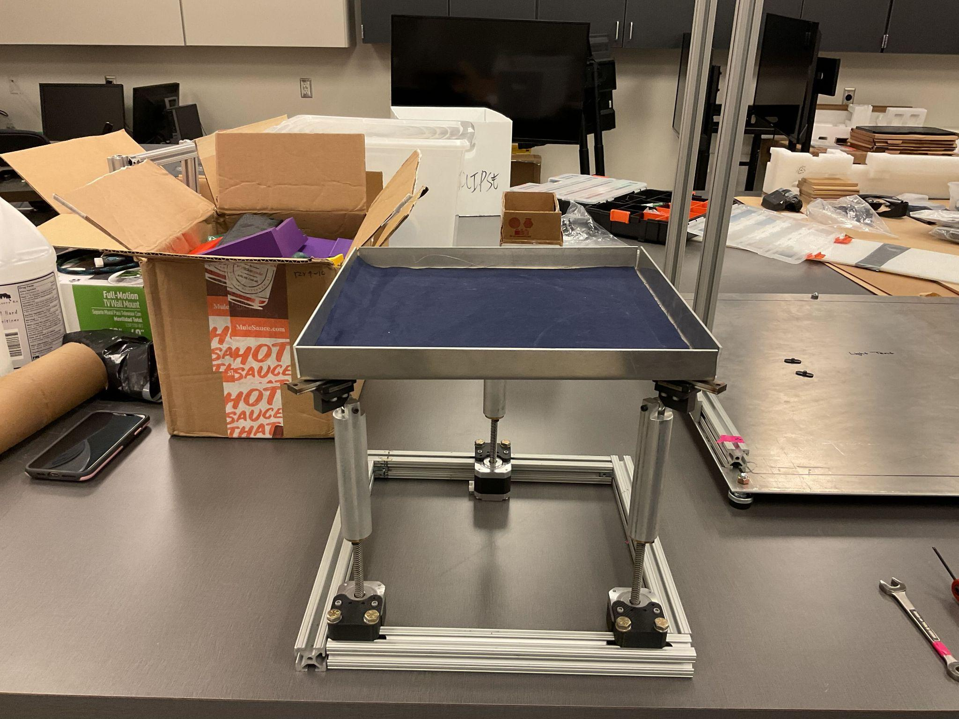

Slide 6
Thank you
I’d like to acknowledge the RIT Capstone Team for their assistance on building SAMI and creating the algorithm.

